Slide 1



Axi4_Lite AVIP
mBits Team
Presenting by,
Muneeeb ulla shariff
Gopal suthar
Mahadevaswamy BN

Slide 2


contents
Introduction
Key Features
TB Architectural
Planning Phase
Implementation
Completion
Execution
Demo of the Project
Verification metrics:
Waveforms
References
Output
Naming convention

Slide 3
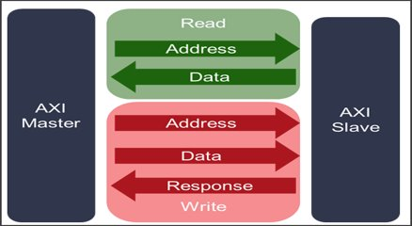
INTRODUCTION: axi4_Lite

Slide 4
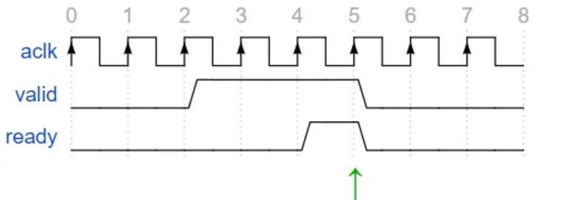
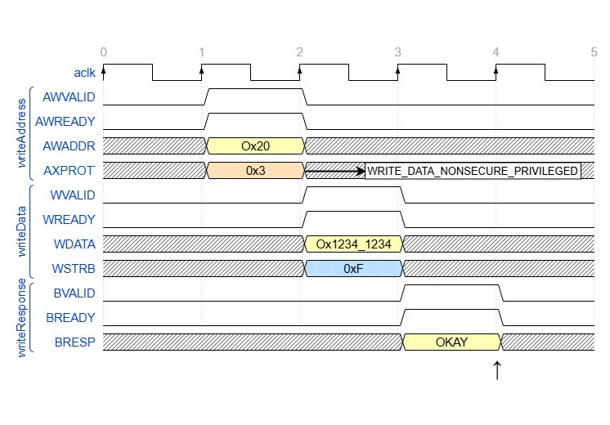
Axi4_Lite Features
Handshaking Mechanism.
Handshake Mechanism for common across all the channels
Handshaking Mechanism for Across each channel
Handshaking Mechanism for Dependency across channels
Transaction structure
Write and read structure
Write and read response structure
Multiple write-read operation
Access permission

Slide 5
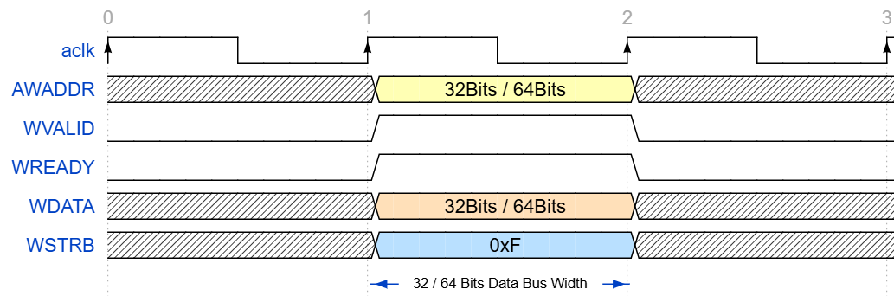
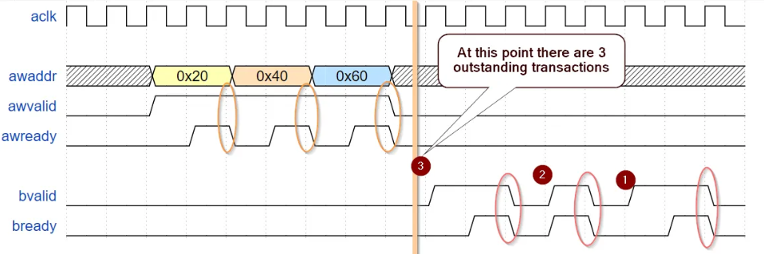
4. All data accesses use the full width of the data bus
5. Supports multiple outstanding transactions

Slide 6
Planning phase
Verification Plan
Testbench Architecture Plan
Directory Structure Plan
Naming Convention Plan

Slide 7
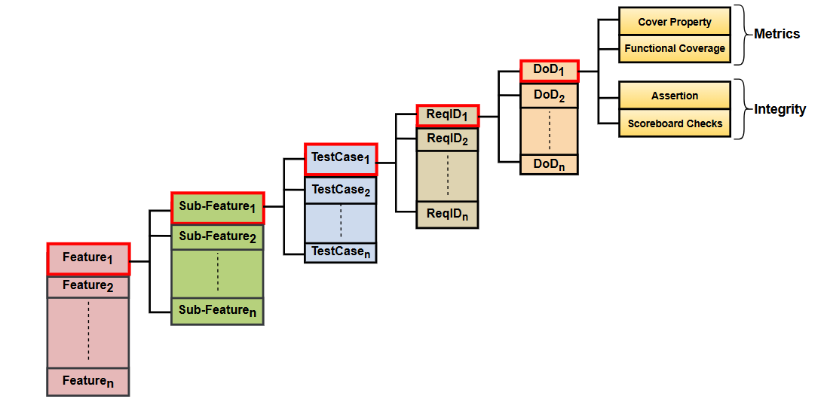
Planning Phase : Verification Plan
Plans :- axi4 Lite all pland doc

Slide 8
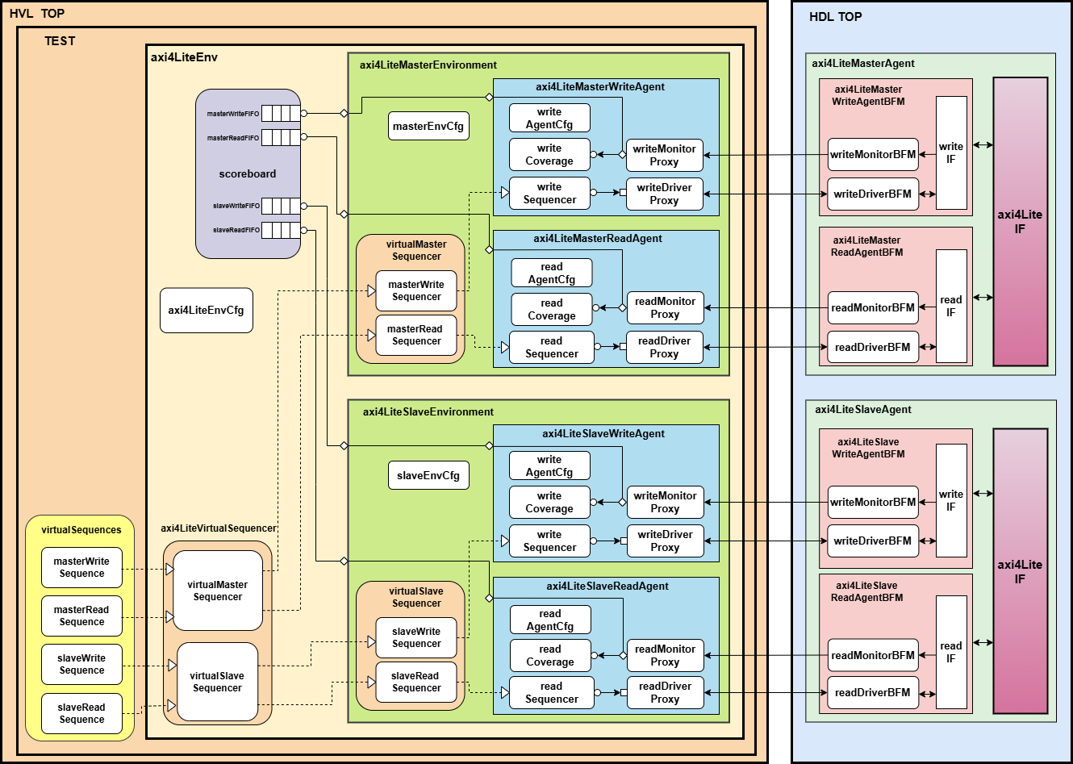
Planning Phase: Test Bench Architecture

Slide 9

single responsibility principle

Slide 10
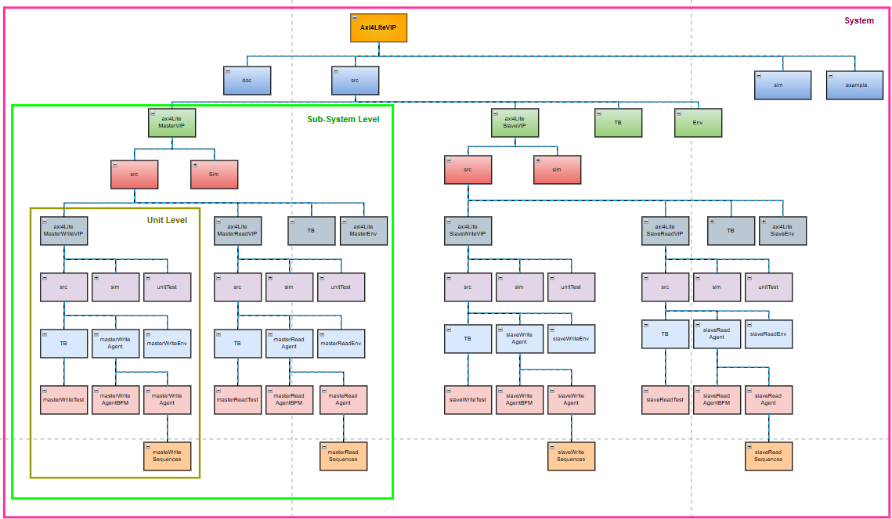
Planning Phase: Directory Structure

Slide 11
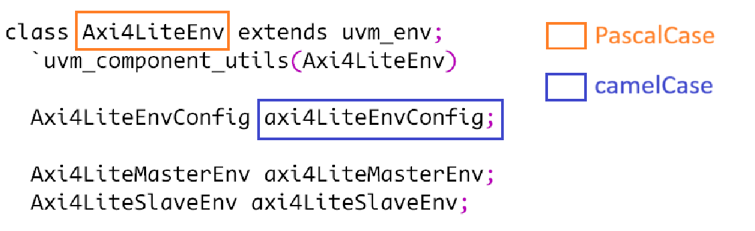

Planning Phase : NAMING Planning phase
Naming convention Naming convention github link ​

Slide 12

Dream To reality
Wouldn't it be good if your VIP could save your development time of your design ?

Slide 13
What if you are working on open-source RTL's, which RTL will you choose ?
Wouldn't it be good if your VIP could do all the evaluation for you ?

Slide 14
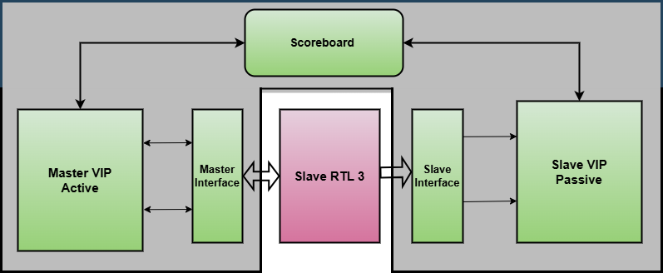
Integration OF The SLAVE RTL3 In real time
Dream To reality

Slide 15
Implementation
Completion
Test bench Components
Master Write Agent
Master Read Agent
Slave Write Agent
Slave Read Agent
Env
Scoreboard
Virtual sequences
Testbench
axi4Lite_avip gitHub Link

Slide 16
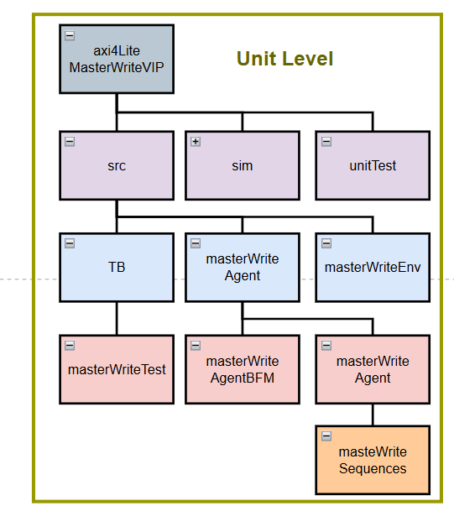
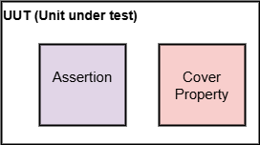
Execution (details VERIFICATION)
Each block execution
axi4Lite_avip gitHub Link

Slide 17
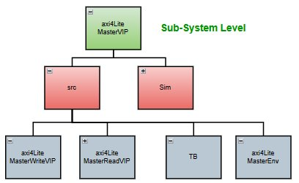
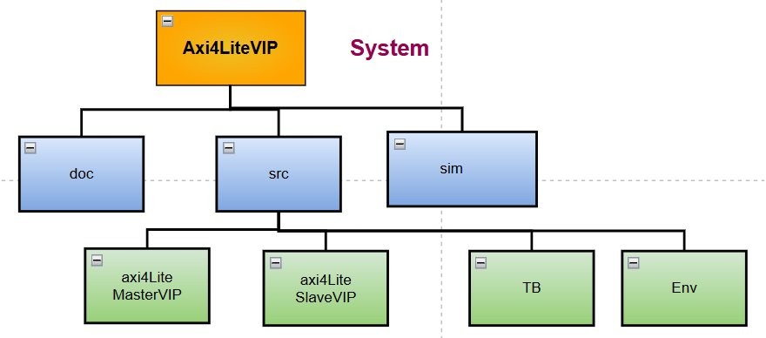
2. Sub - System level Execution
3. System level execution
Test Suite execution

Slide 18
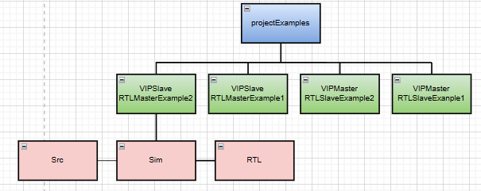
4. At last execution with new RTL
Test suite execution and Python script execution

Slide 19
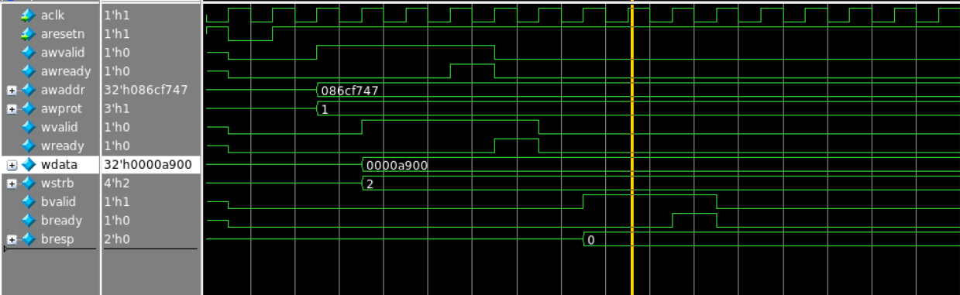
Waveform output
Simulation Results​
Write transfers

Slide 20
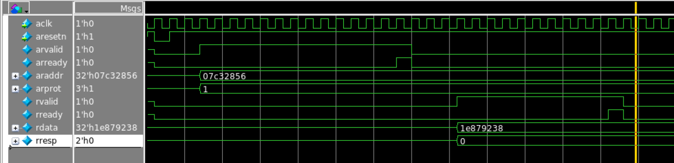
Read Transfers

Slide 21
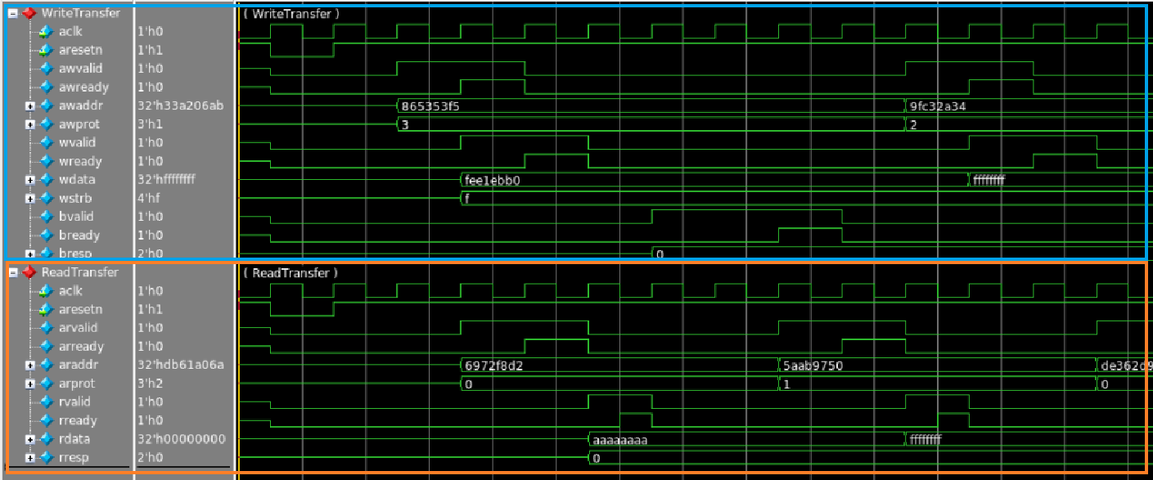
Parallel Write and Read Transfers

Slide 22
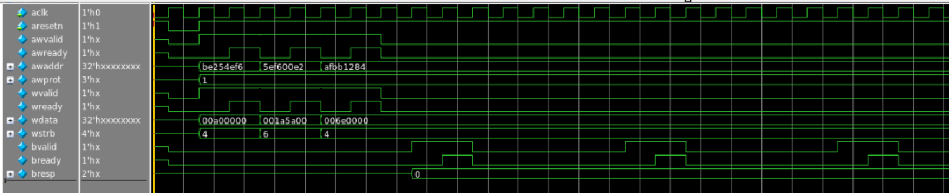
Multiple Outstanding write transaction

Slide 23
Simulation Results: Metrics & Integrity
Verification Metrics
Assertion checks
Coverage checks
Functional Coverage
Verification Integrity
Scoreboard Checks
Assertion checks

Slide 24
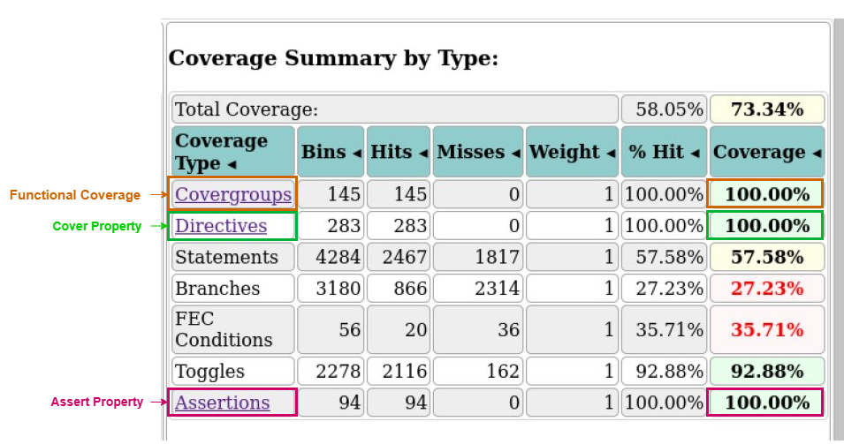
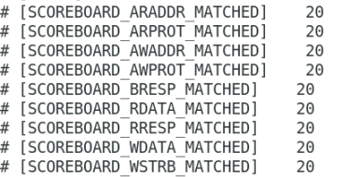
Coverage closer
Total coverage
Click here for regression excution and report

Slide 25


RTL verification using the VIP
Master RTL 2. Slave RTL
We connected those RTL To our VIP and we written test suite for the regression
We wrote the script for the regression, after regression done it'll automatically execute, and it will give output as a how many features and requirements are there and how many failed.

Slide 26
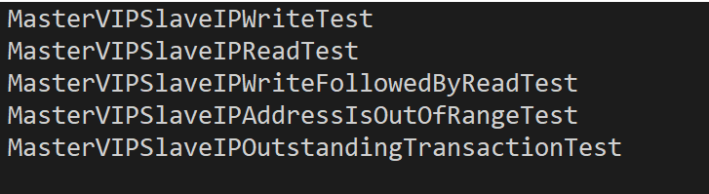
Test suit for the RTL Verification
In our test suit we have the 5 test cases, those are not only 5 testcases but Inside each tests we are going to randomize the mutiple number of times until the covarage will not hit 100 percentage If not 100 percentage it'll repeat 100 times and come out of the loop.

Slide 27
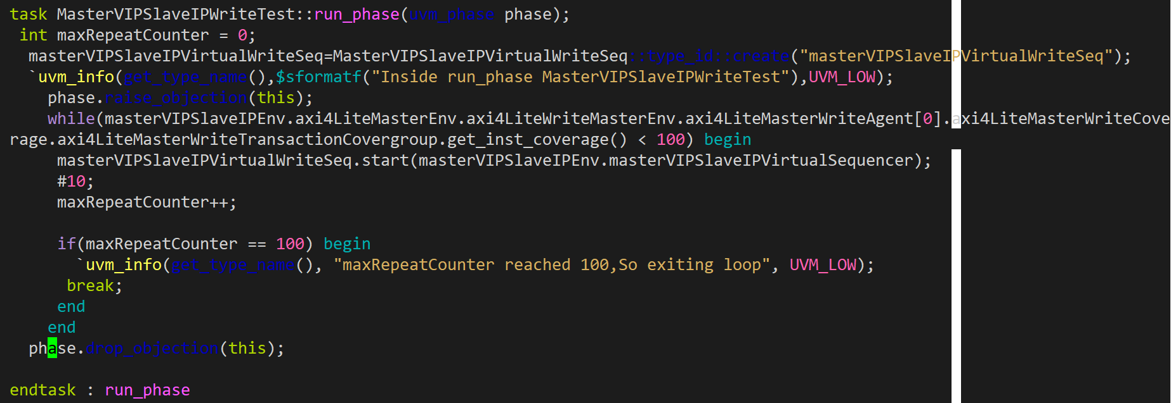
artificial intelligence Test case

Slide 28
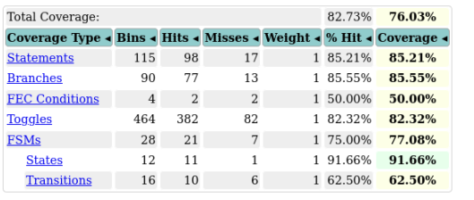
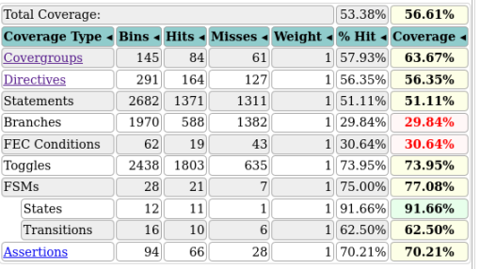
Output of the script
Regression Report

Slide 29
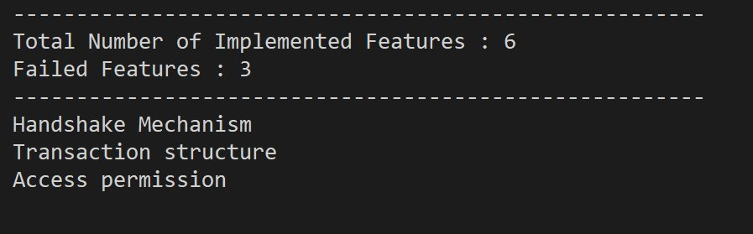
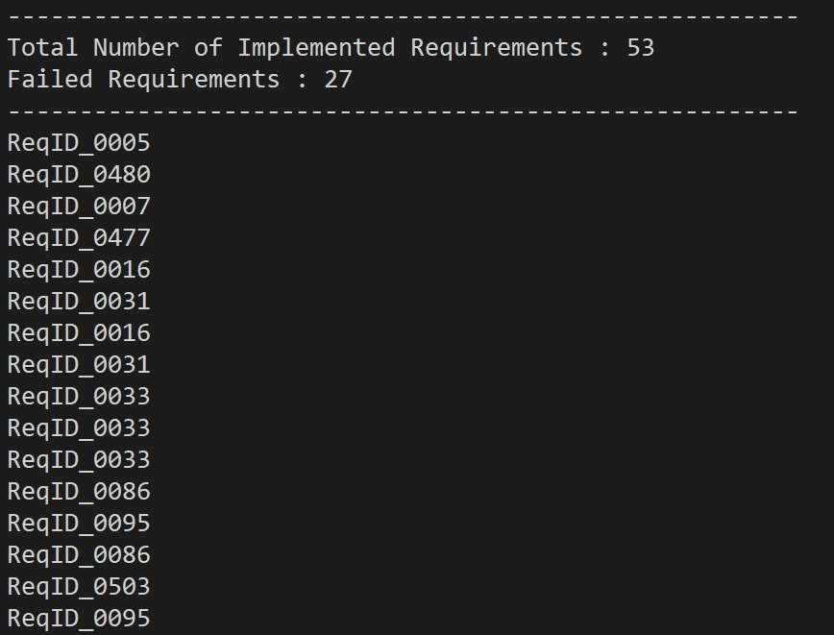
Violated Features Violated Requirements

Slide 30
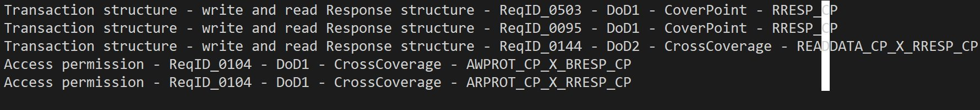
Violated Features in Details

Slide 31
RTL bugs
In the below link we listed down Slave RTL bug on the GitHub issue
Slave RTL Bugs issues link
Slave RTL Code coverage analysis
Code coverage link for Slave RTL

Slide 32
References
ARM Axi4-lite specification : axi4Lite Specification Doc
Wavedrom : Wavedrom_tutorial_link
MBits Avip flow : mBits_avip flow

Slide 33
AXI4_AVIP: axi4_avip github link
AXI4_LITE_AVIP: axi4Lite_avip github link

Slide 34
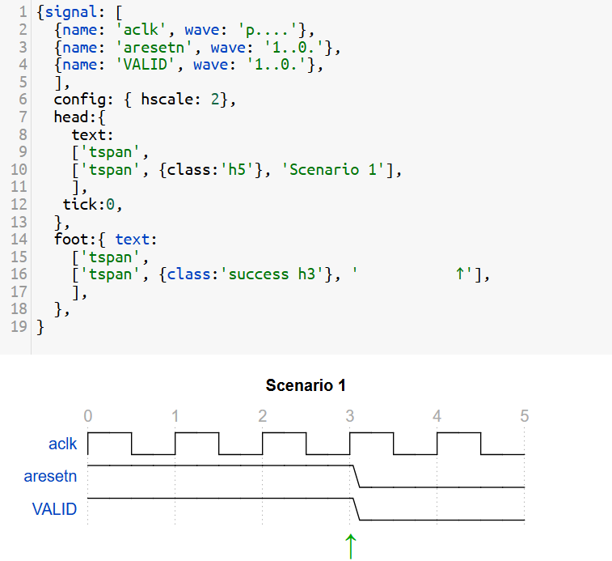
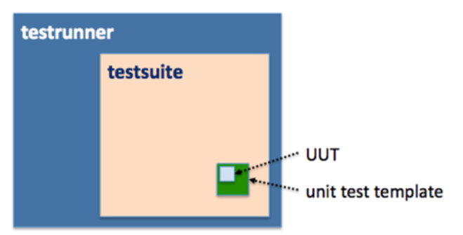
Unique feature of the VIP
Unit level testing
2. Wave dorm waveform
3. SvUnit

Slide 35
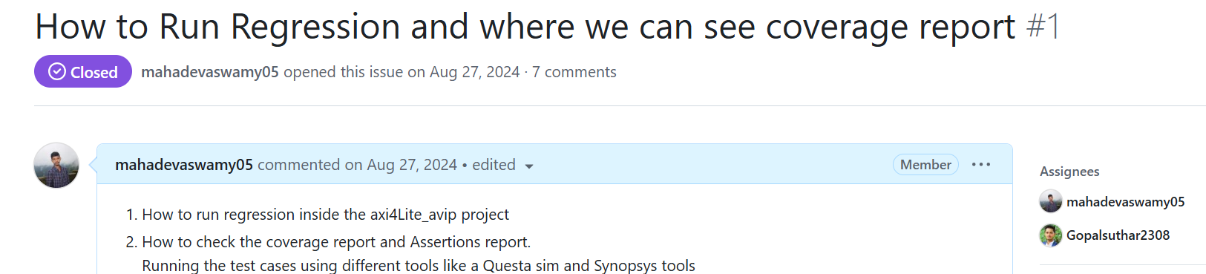
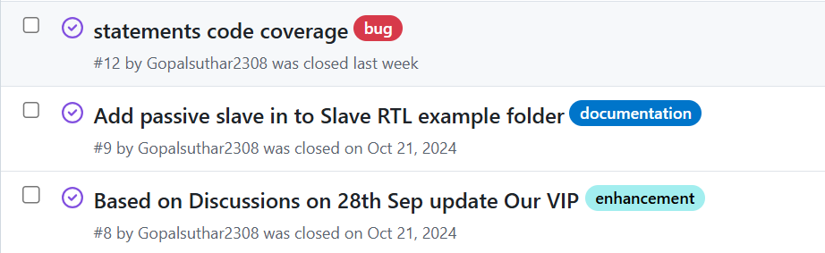
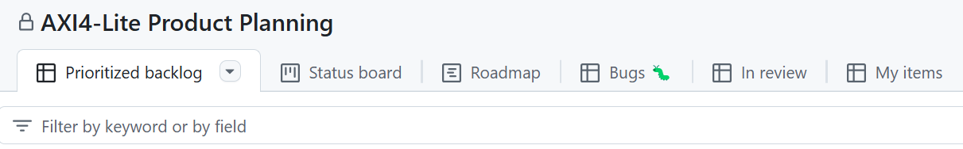
4. Documents in GitHub issues
Click here for regression excution and report
5. Issue tracker
6. GitHub project management : Product Planning

Slide 36
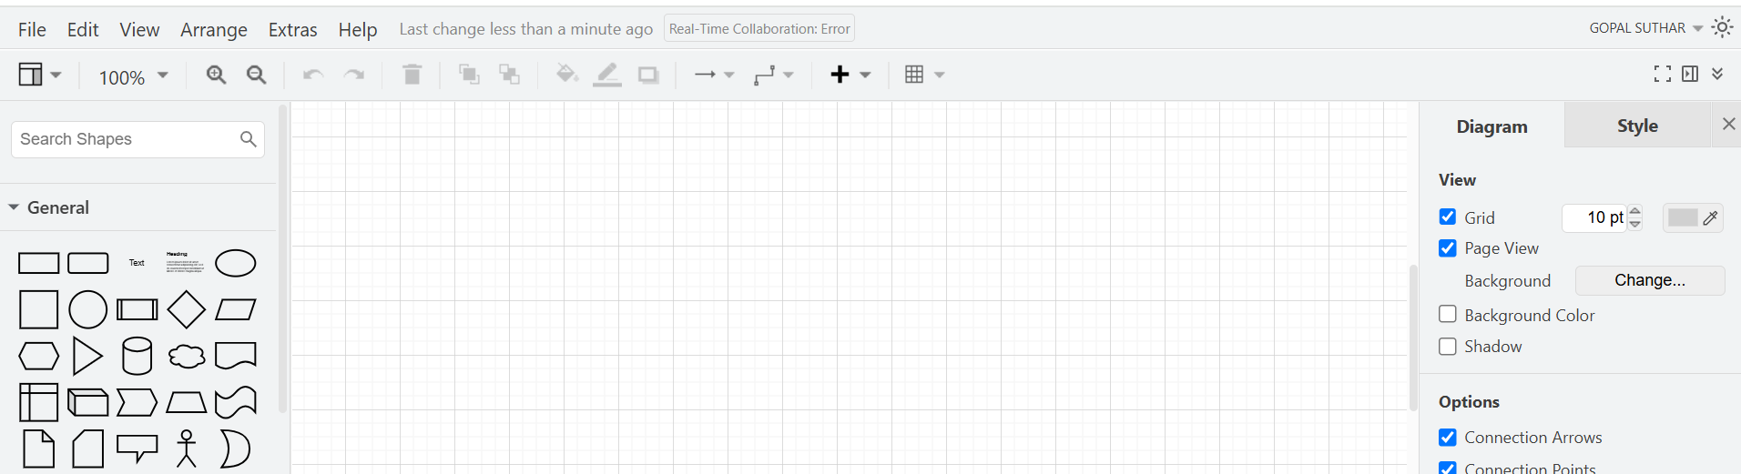
7. Structure diagram maker Draw.io
8. Good open-source documentation

Slide 37
9. Advanced UVM concepts
10. Sequence layering
11. Exhaustive intelligent Test suite

Slide 38
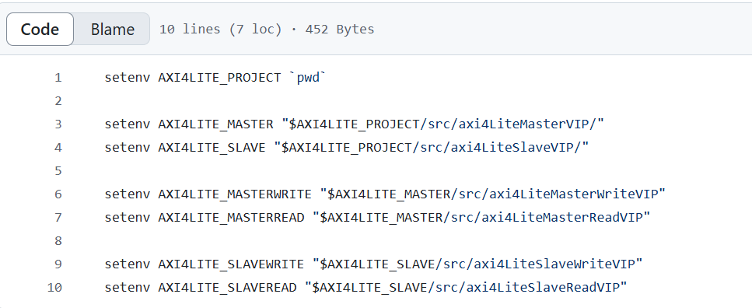
12. Script for automatically generating the violated features
13. Automatic Evalution ability
14. Setup environment

Slide 39
Q & A

Slide 40

Contact details
mbits@mirafra.com

